Slide 1

DESIGNING AND DEVELOPMENT OF MASSIVE OPEN ONLINE COURSE FOR FATONI UNIVERSITY (FTU MOOC)
1. HIYAM SASU 602431008
2. E-BADIYAH JEHSANI 592431013

Slide 2
TABLE OF CONTENTS
01
INTRODUCTION
05
SUMMARY
02
PROBLEM STATEMENT
03
OBJECTIVE
04
METHODOLOGY

Slide 3
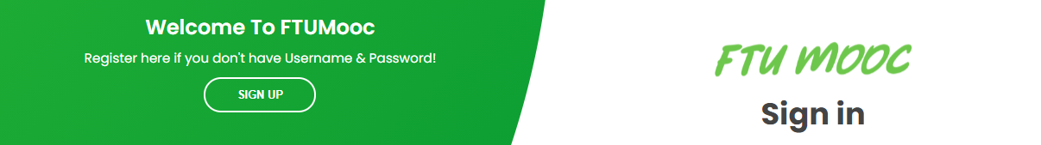
01 INTRODUCTION
This project is an online study and it is for everyone
that do not have time to take a note at the time of the lesson
or have special cases who cannot attend classes.

Slide 4
PROBLEM STATEMENT
02
From an assess the massive open online course for Fatoni university (FTU MOOC) efficiency and quality as the old way that already exists,
be able to identify the problem as follows:
How to register in the system is out of date.
Students also do not know whether they have passed the course or
not or if they improve their knowledge in this courses.
Also, after studying, they have no proof that they studied these courses

Slide 5
OBJECTIVE
03
The main purpose of this project is to
Develop, refactoring and add new features
massive open online course

Slide 6
Actor
1. Administrator
2. Lecturer
3. Student
Status of requirement
1. Done
2. In process
3. Not don’t yet

Slide 7
1. Manage Registration
Status | Requirement ID | Requirement Description | result
REF | REF_01_01,(ER_01_01) | Lecturer register to be lecturer
REF | REF _01_02, (ER_01_02) | Student register course to be member course

Slide 8
2. Manage Login
Status | Requirement ID | Requirement Description | result
REF | REF_02_01,(ER_02_01) | Lecturer login
REF | REF _02_02, (ER_02_02) | Admin login
REF | REF _02_03, (ER_02_03) | Student login
ADD | ADD_02_04 | Login via social media

Slide 9
3. Manage User
Status | Requirement ID | Requirement Description | result
REF | REF_03_01,(ER_03_01) | Admin can assign system role of user account
REF | REF _03_02, (ER_03_02) | Admin can CRUD student account
REF | REF _03_03, (ER_03_03) | Admin can CRUD lecturer account

Slide 10
4. Manage User Account
Status | Requirement ID | Requirement Description | result
ADD | ADD_04_01 | Admin can view student profile
ADD | ADD_04_02 | Admin can view lecturer profile
ADD | ADD_04_03 | Admin can CRUD student profile
ADD | ADD_04_04 | Admin can CRUD lecturer profile
ADD | ADD_04_05 | Lecturer can view student profile
ADD | ADD_04_06 | Lecturer can CRUD own profile
ADD | ADD_04_07 | Student can view lecturer profile
ADD | ADD_04_08 | Student can CRUD own profile

Slide 11
5. Manage Courses
Status | Requirement ID | Requirement Description | result
REF | REF_05_01, (ER_05_01) | Admin can CRUD course
REF | REF_05_02, (ER_05_02) | Admin can CRUD course categories
REF | REF_05_03, (ER_05_03) | Admin can CRUD course subcategories
REF | REF_05_04, (ER_05_04) | Lecturer can CRUD course
REF | REF_05_05, (ER_05_05) | Lecturer can view they own course
REF | REF_05_06, (ER_05_06) | Lecturer can choose course category
REF | REF_05_07, (ER_05_07) | Lecturer can follow student course progress
REF | REF_05_08, (ER_05_08) | Student can register course
ADD | REF_05_09 | Student can view they own course progress

Slide 12
6. Manage Courses Lessons
Status | Requirement ID | Requirement Description | result
REF | REF_06_01,(ER_06_01) | Admin can CRUD lesson
REF | REF _06_02, (ER_06_02) | Lecturer can CRUD lesson
REF | REF _06_03, (ER_06_03) | Lecturer can CRUD activity in course lesson
REF | REF _06_04, (ER_06_04) | Lecturer can CRUD media in course lesson
REF | REF _06_05, (ER_06_05) | Student can study lesson

Slide 13
7. Manage Course Quiz
Status | Requirement ID | Requirement Description | result
ADD | ADD_07_01 | Admin can CRUD courses examination
ADD | ADD_07_02 | Lecturer can CRUD multiple choice quiz chapter
ADD | ADD_07_03 | Student can take quiz course

Slide 14
8. Manage Quiz Result
Status | Requirement ID | Requirement Description | result
ADD | ADD_08_01 | Admin can view study result of student
ADD | ADD_08_02 | Lecturer can view study result of student
ADD | ADD_08_03 | Student can view their own study result

Slide 15
9. Manage Price
Status | Requirement ID | Requirement Description | result
ADD | ADD_09_01 | Admin can manage the price
ADD | ADD_09_02 | Lecturer can CRUD the price
ADD | ADD_09_03 | Student can pay the courses

Slide 16
10. Manage Course Certificate
Status | Requirement ID | Requirement Description | result
ADD | ADD_10_01 | Lecturer can manage certificate
ADD | ADD_10_02 | student can get certificate

Slide 17
11. Manage Discussion and Comment
Status | Requirement ID | Requirement Description | result
ADD | ADD_11_01 | Admin can manage comments
ADD | ADD_11_02 | User can CRUD comments

Slide 18
Result
All | Success
50 | 50

Slide 19
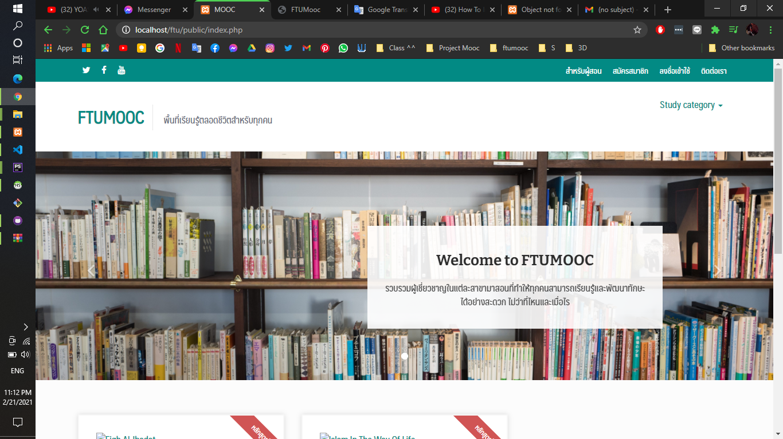
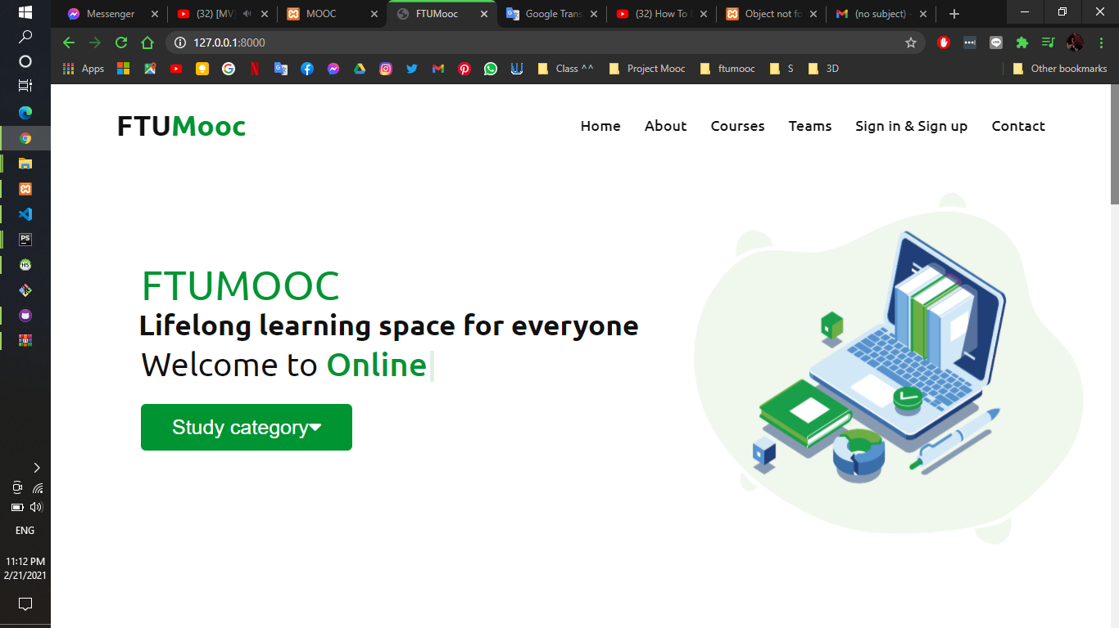
Home page

Slide 20
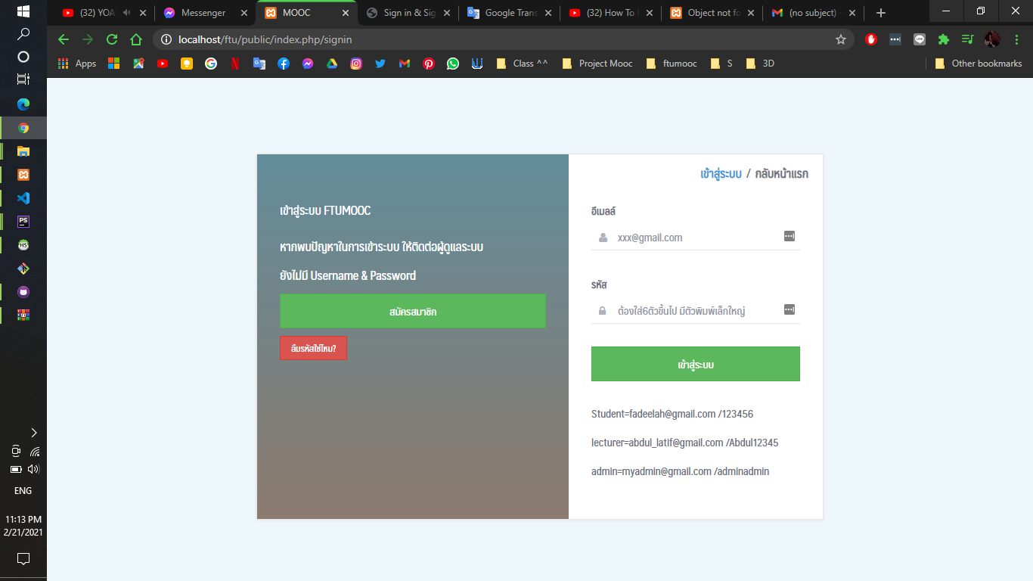
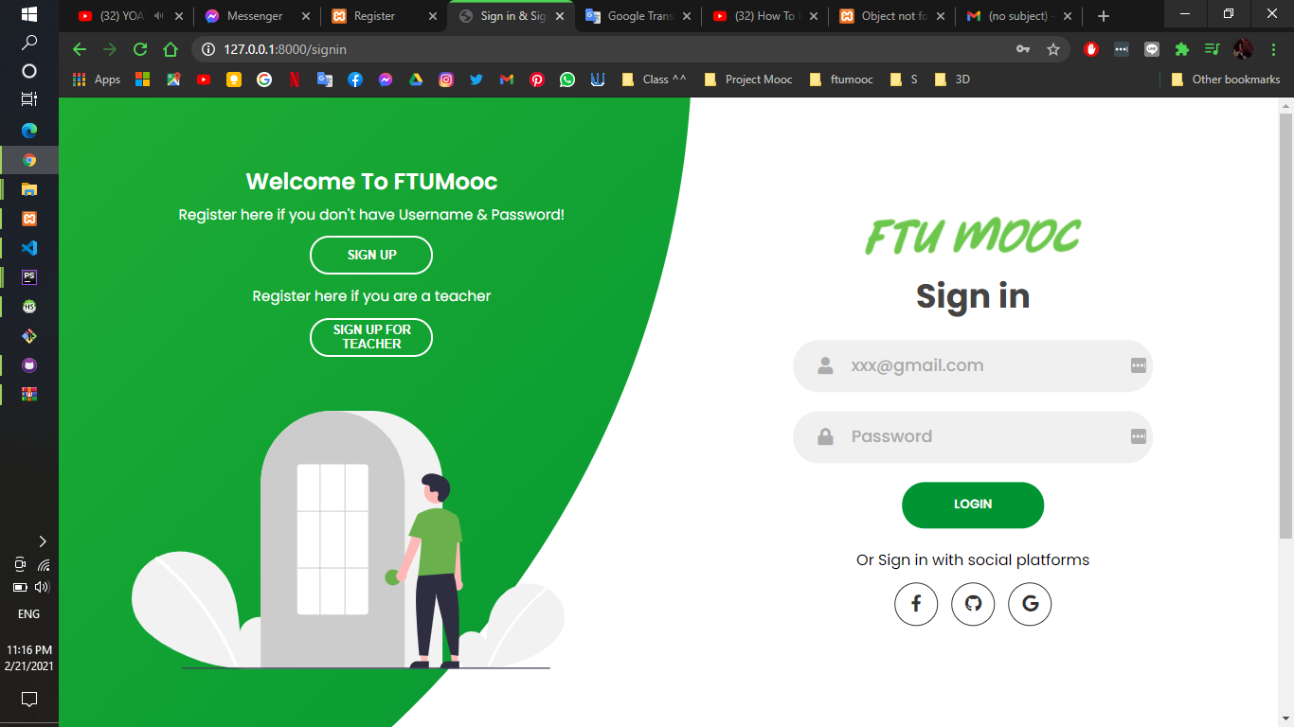
Login page

Slide 21
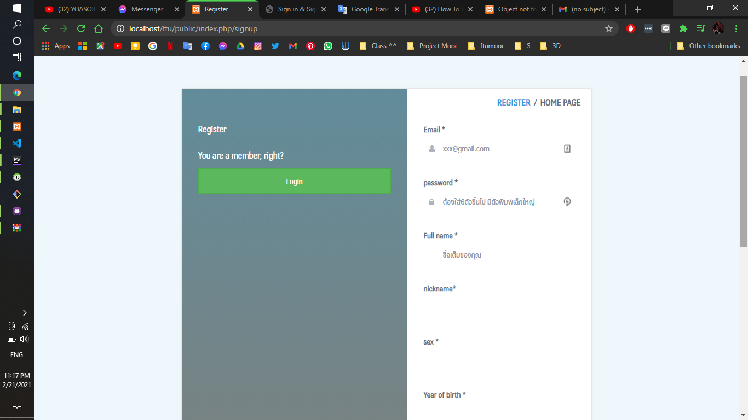
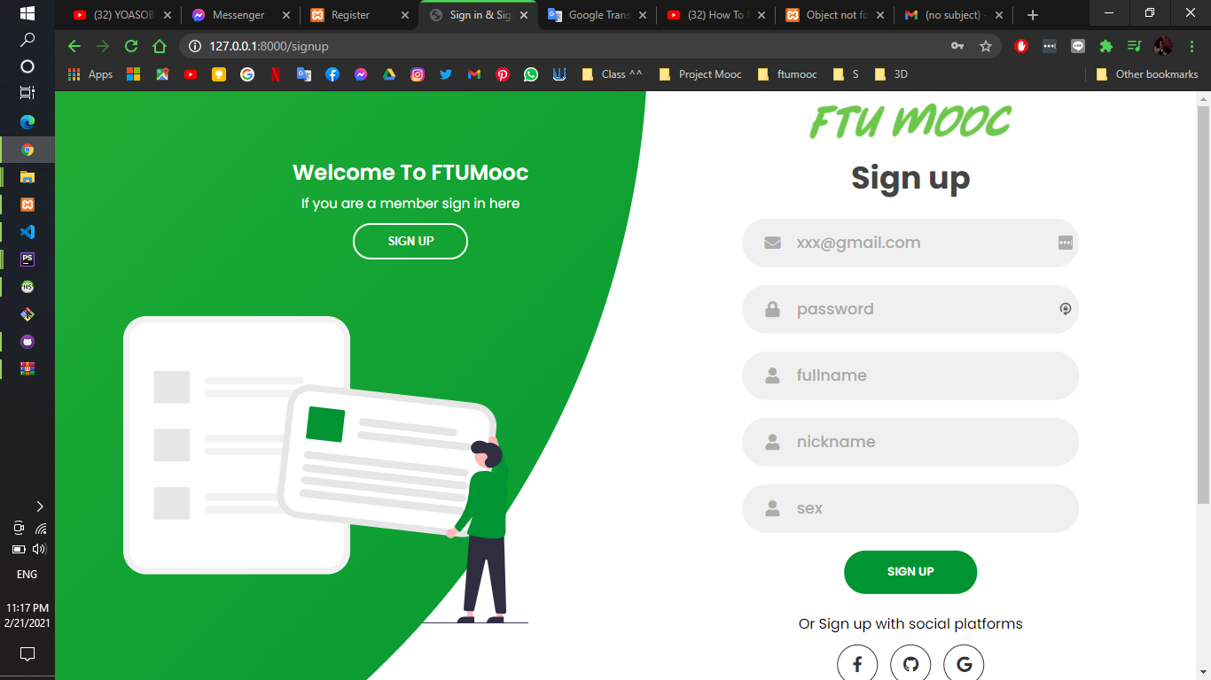
Register page

Slide 22
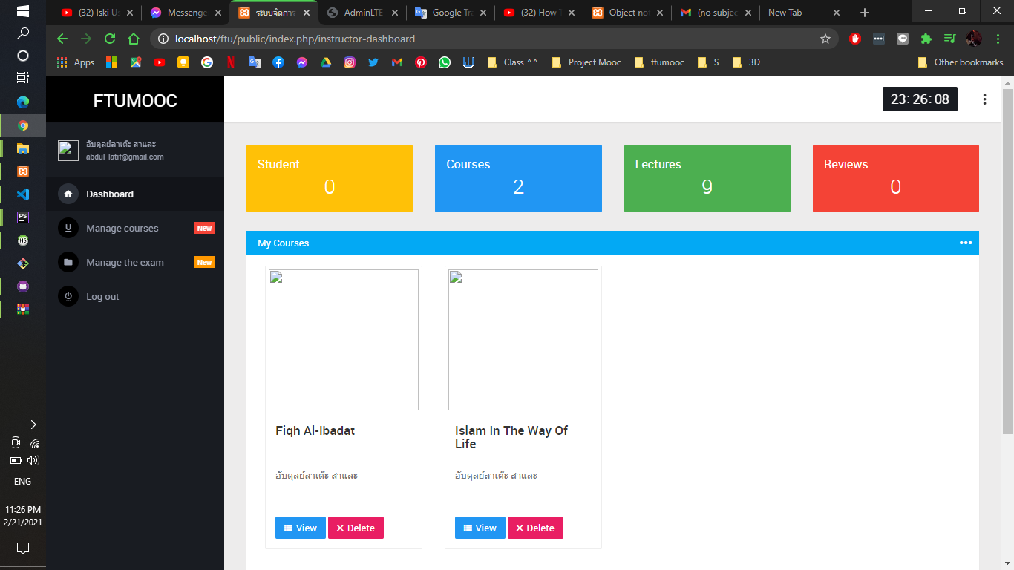
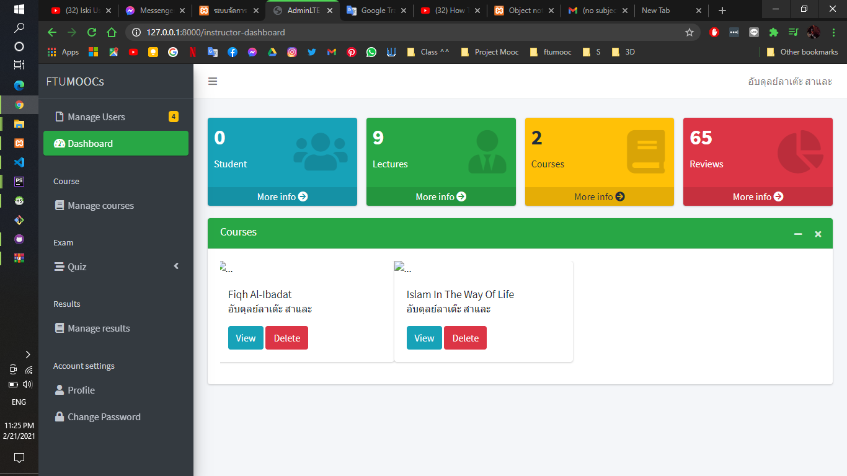
Dashboard page

Slide 23
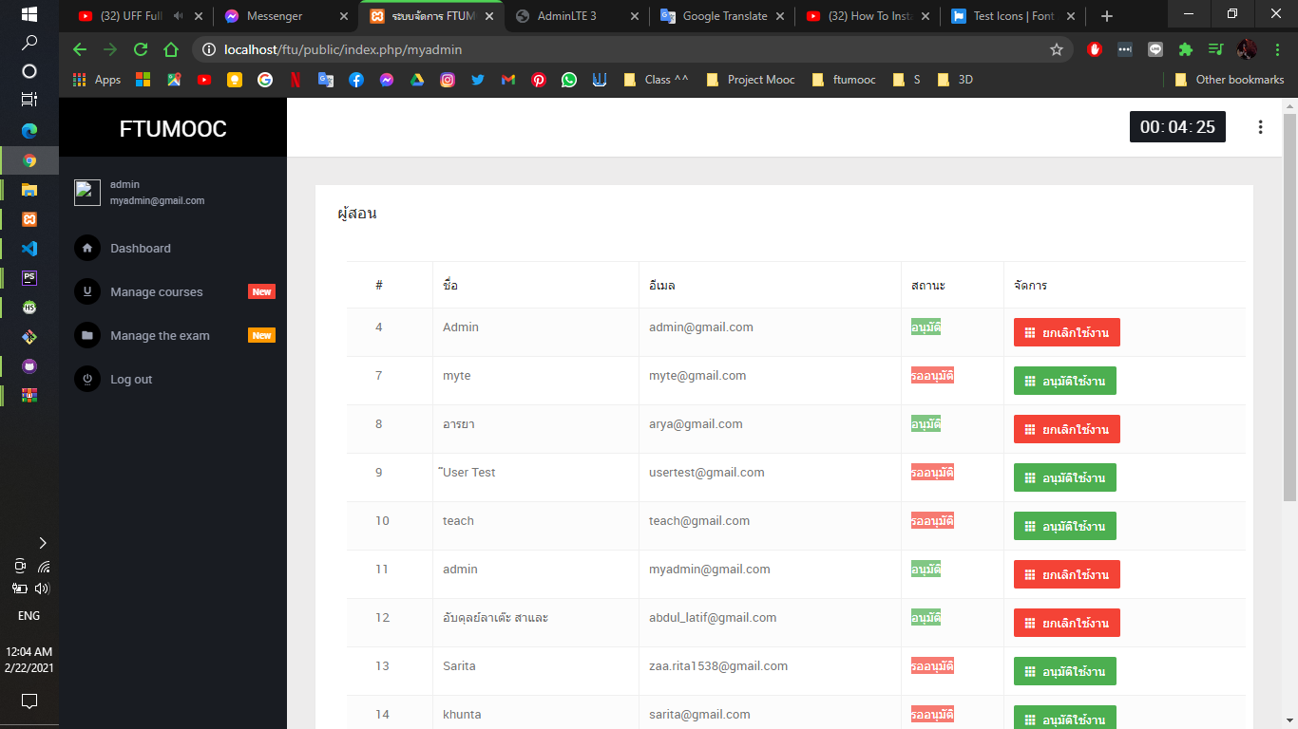
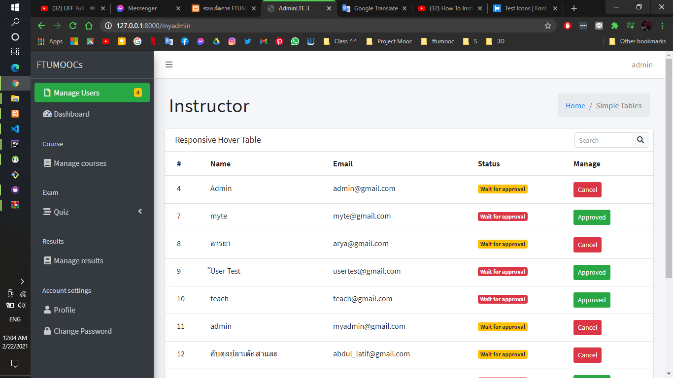
Admin manage status of Lecturer and Student page

Slide 24
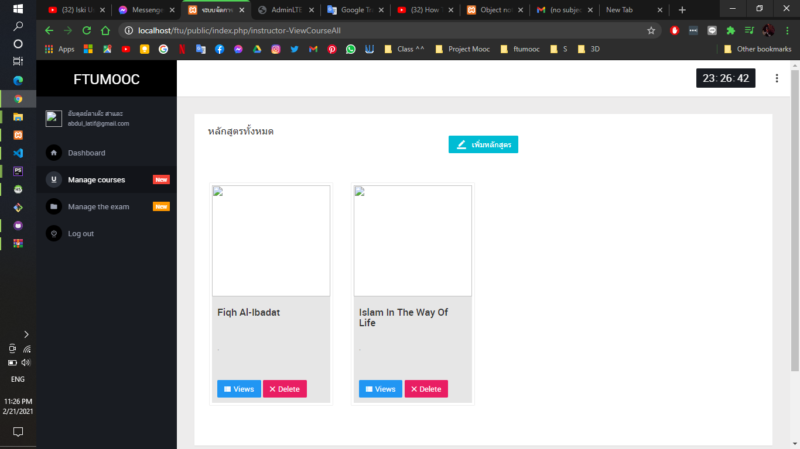
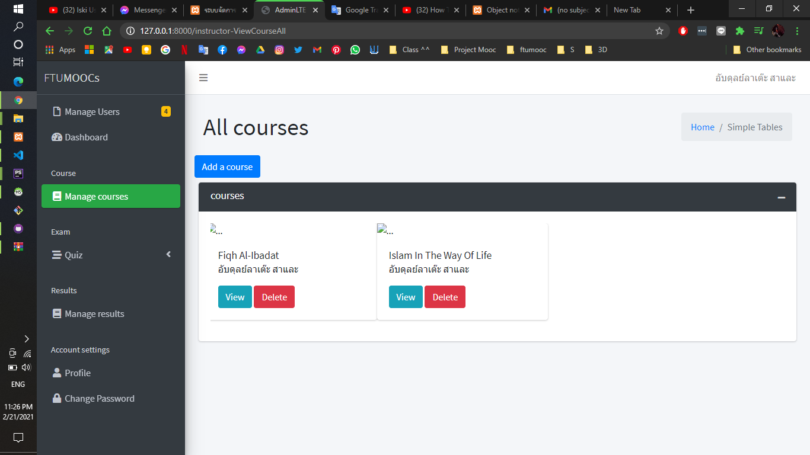
Manage courses page

Slide 25
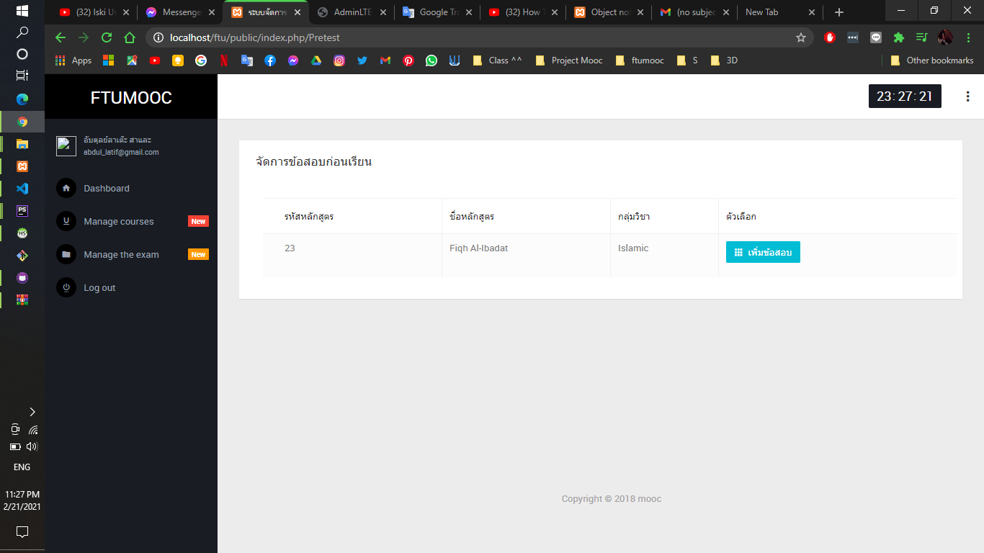
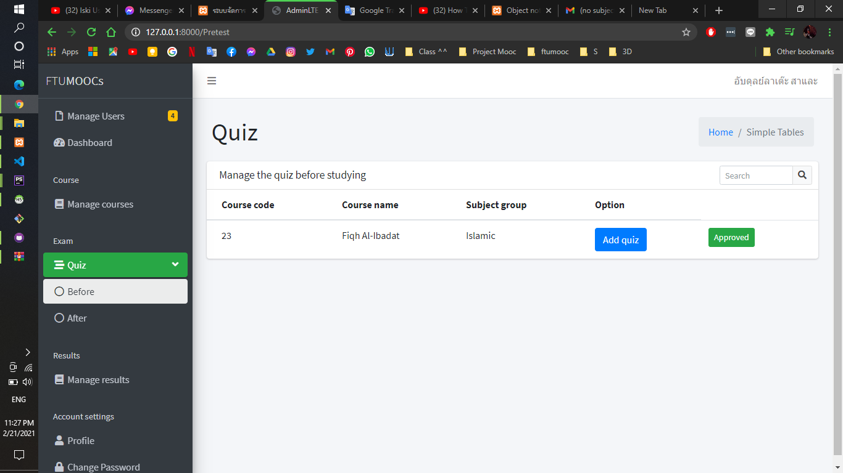
Manage quiz page

Slide 26
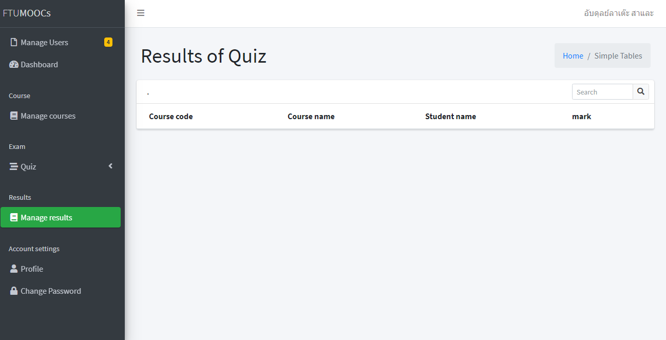
Manage result page

Slide 27
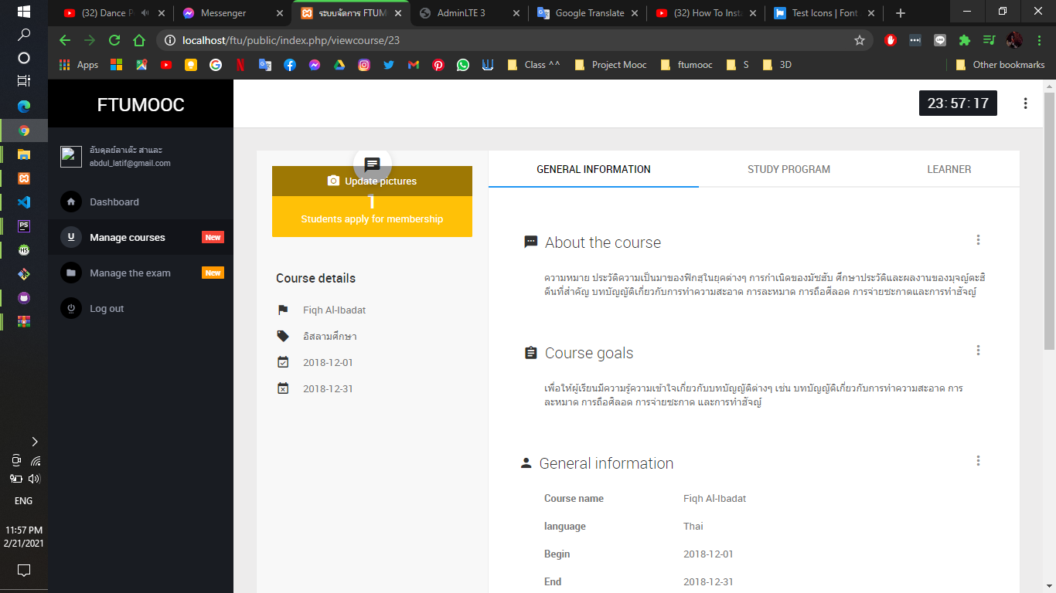
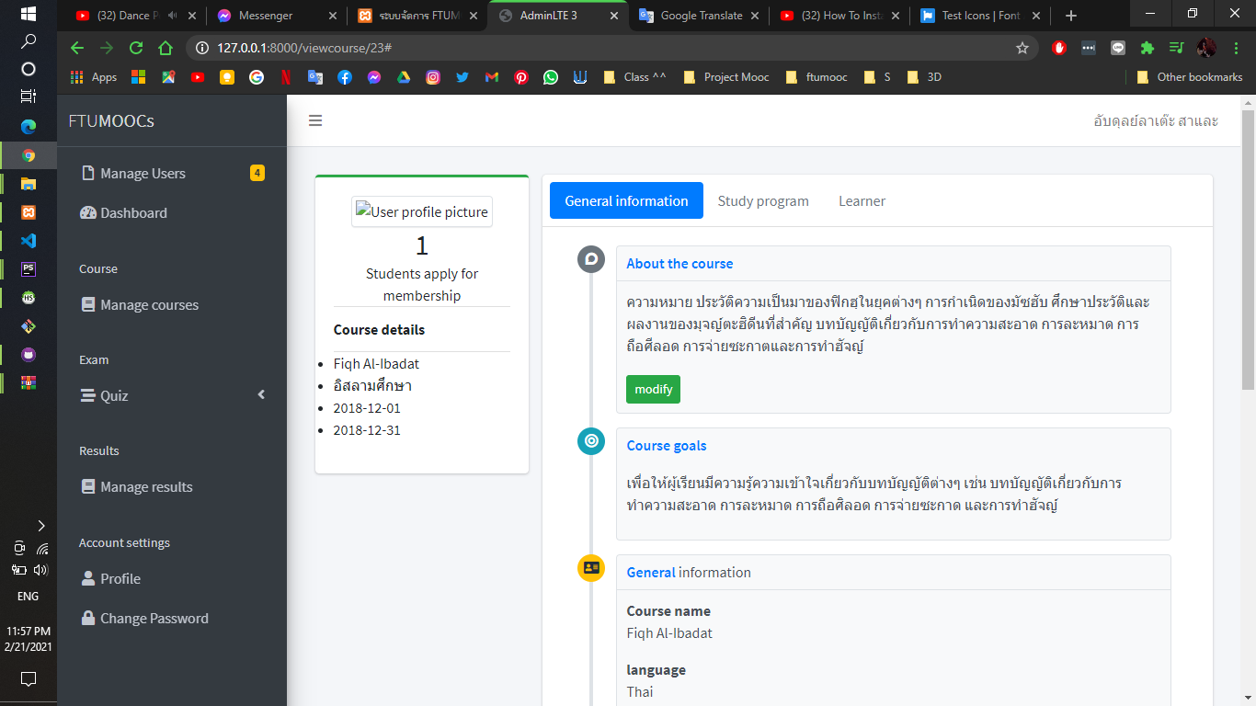
View course page

Slide 28
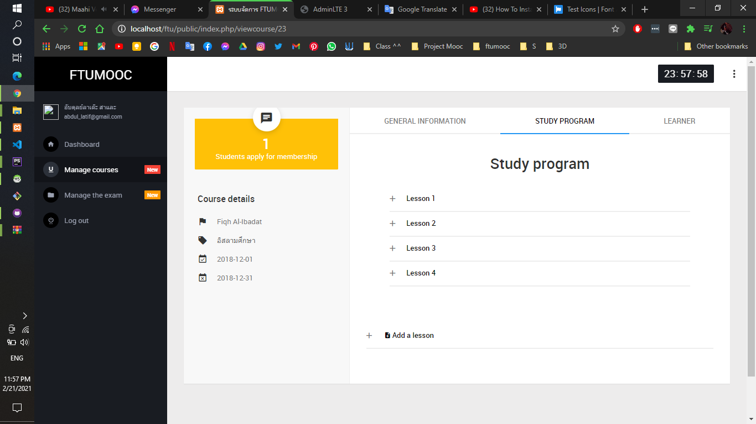
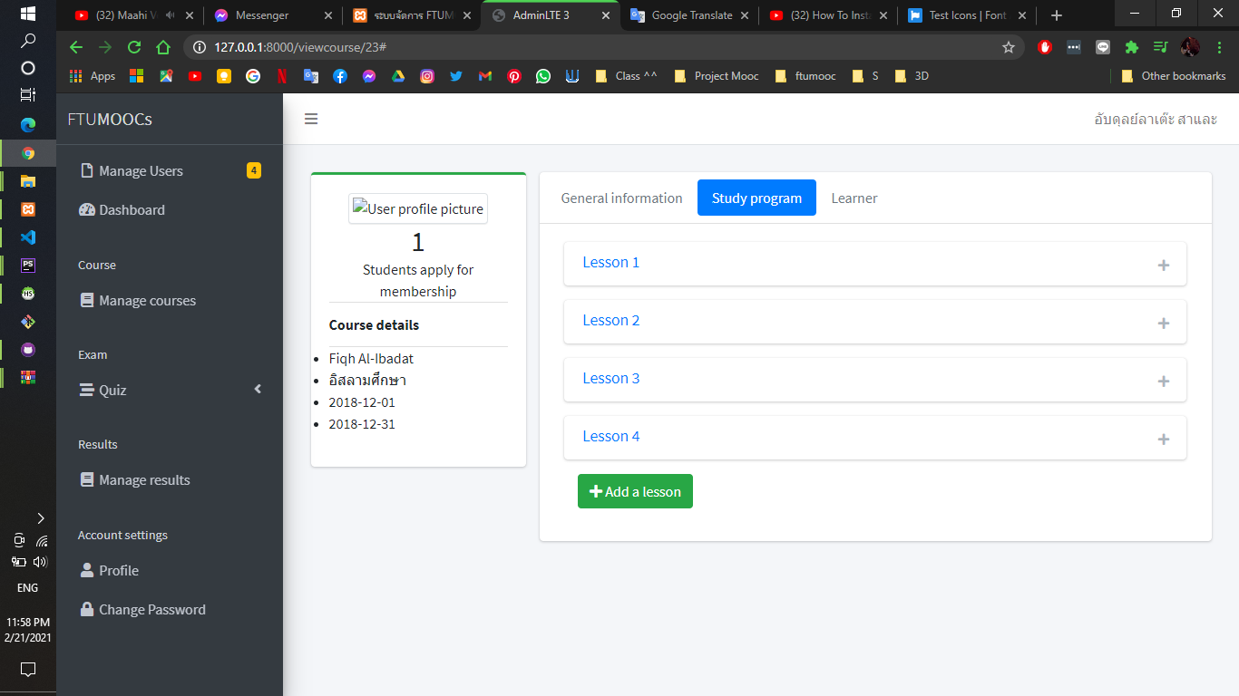
CRUD study program page

Slide 29
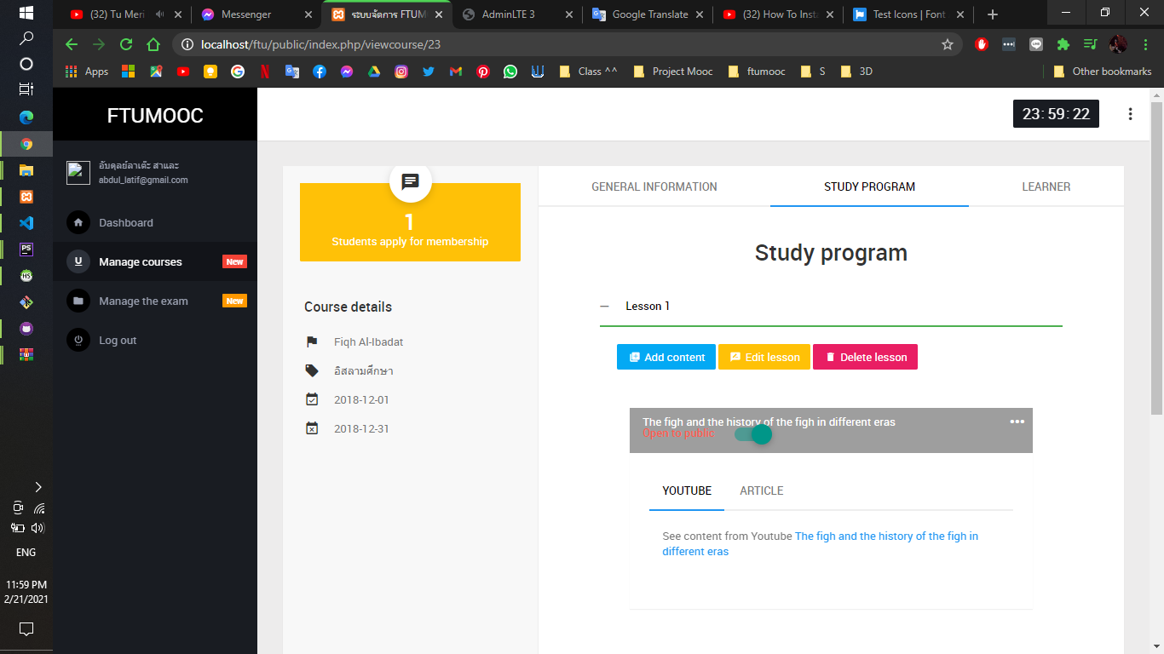
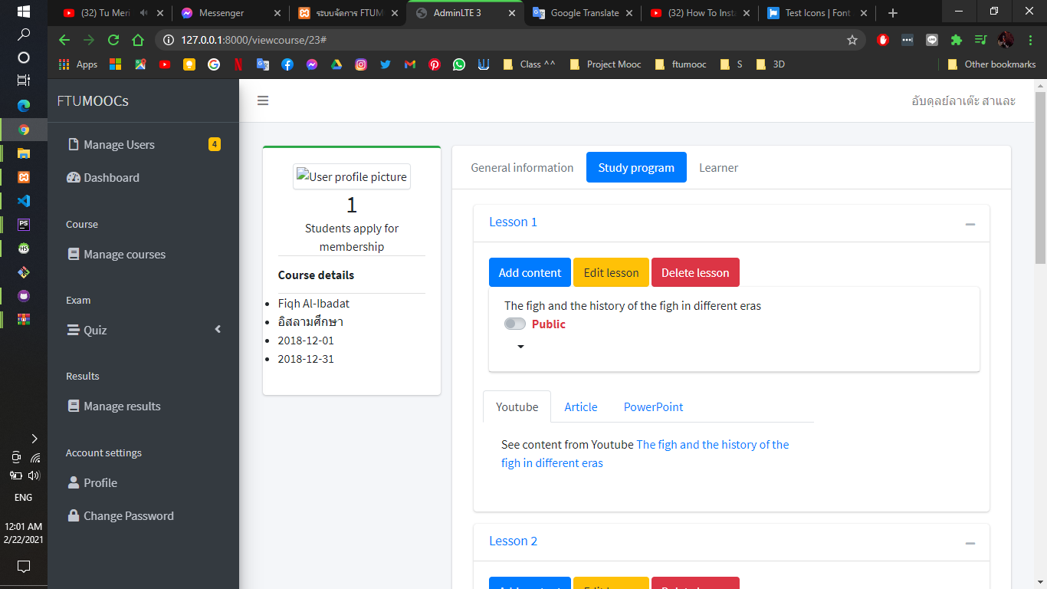
Study program page

Slide 30
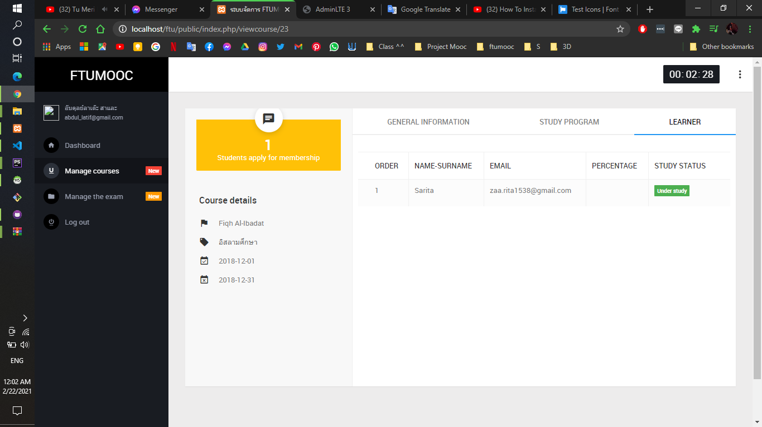
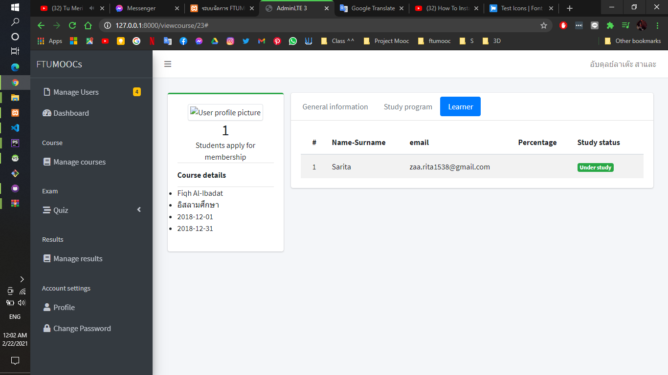
View learner page

Slide 31
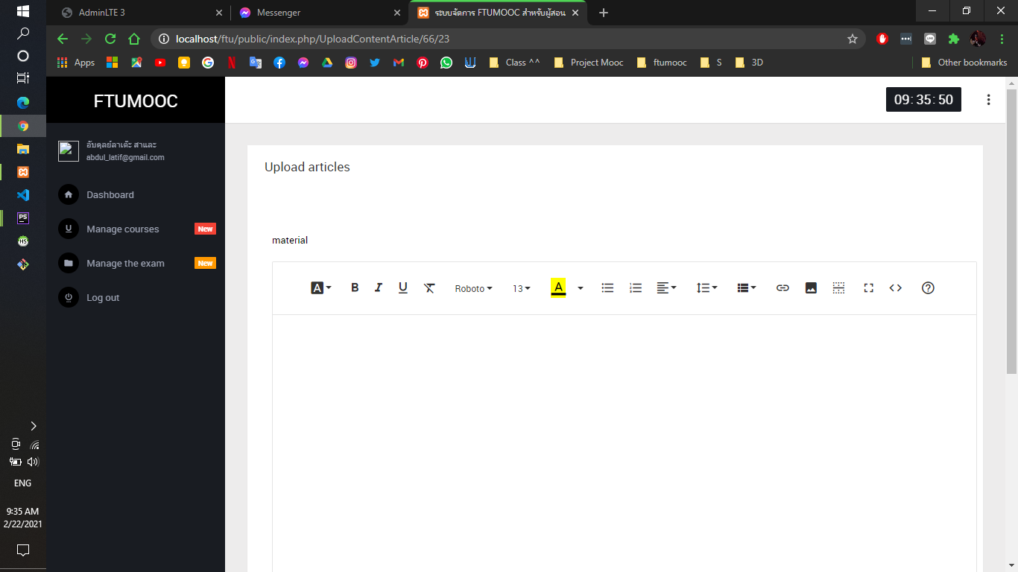
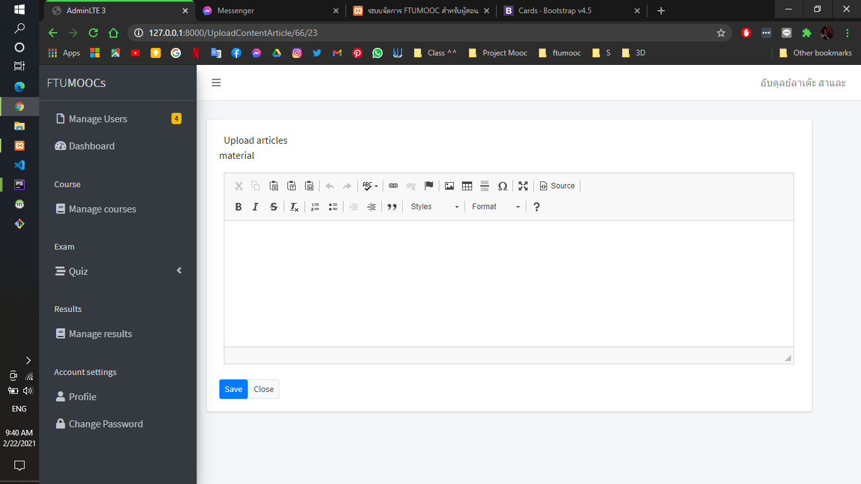
Upload content article page

Slide 32
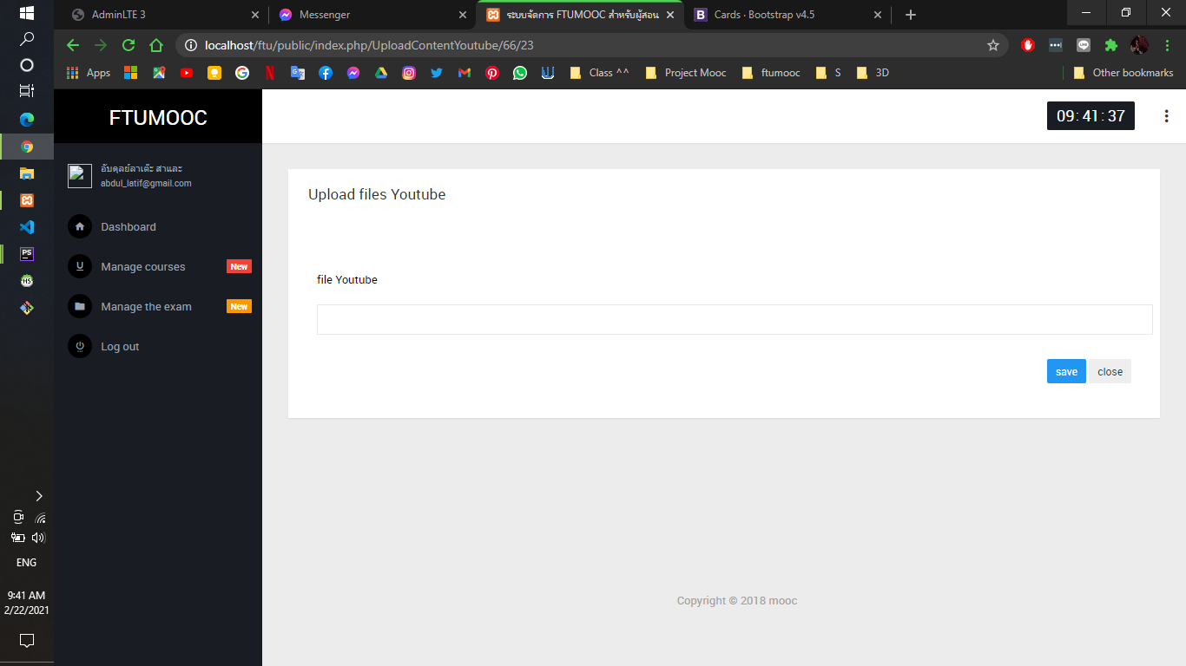
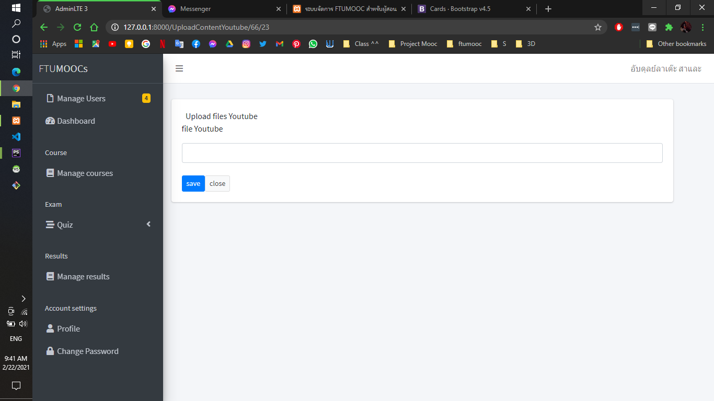
Upload content YouTube page

Slide 33
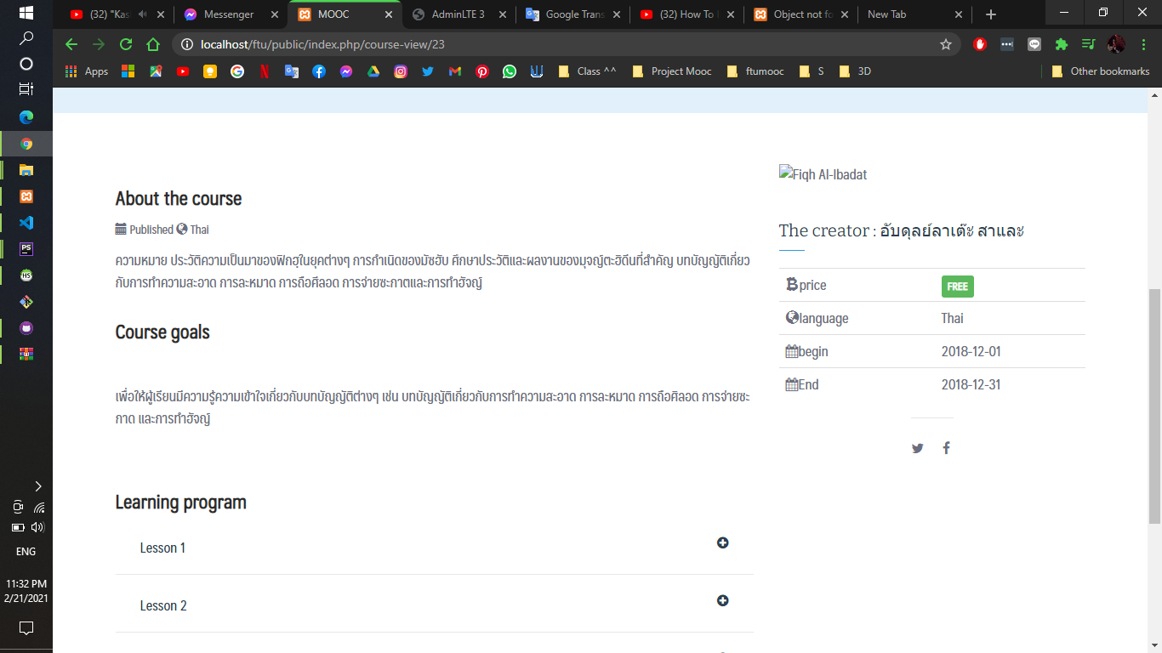
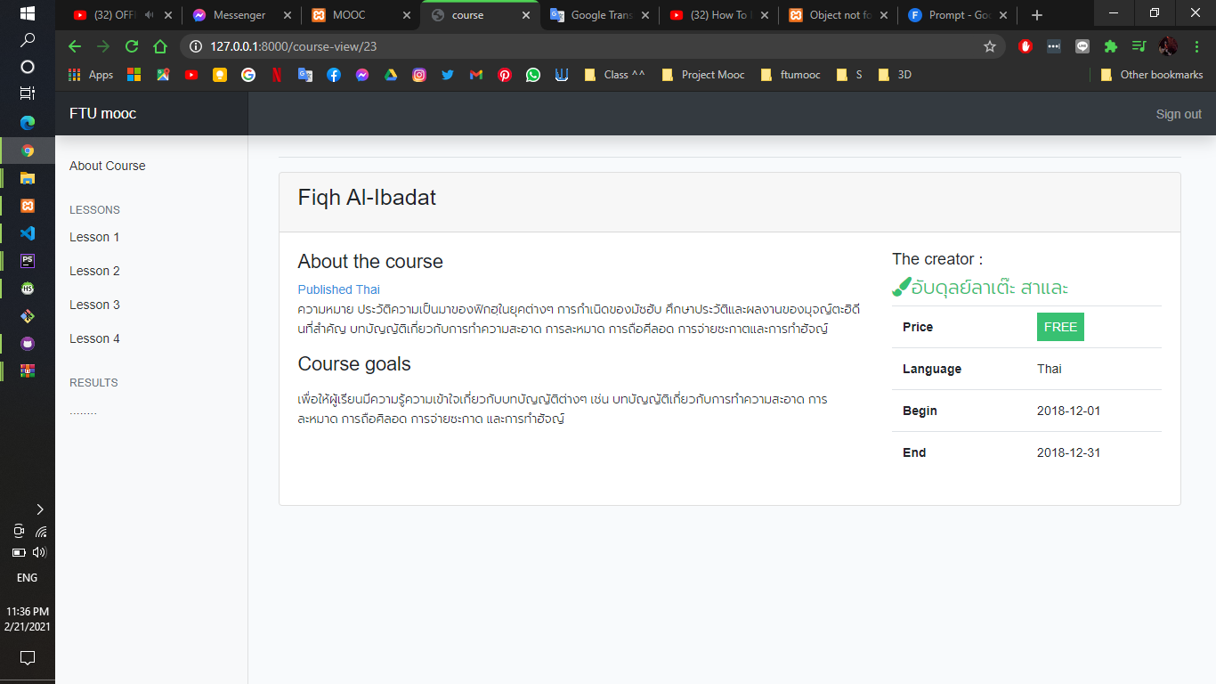
About course page

Slide 34
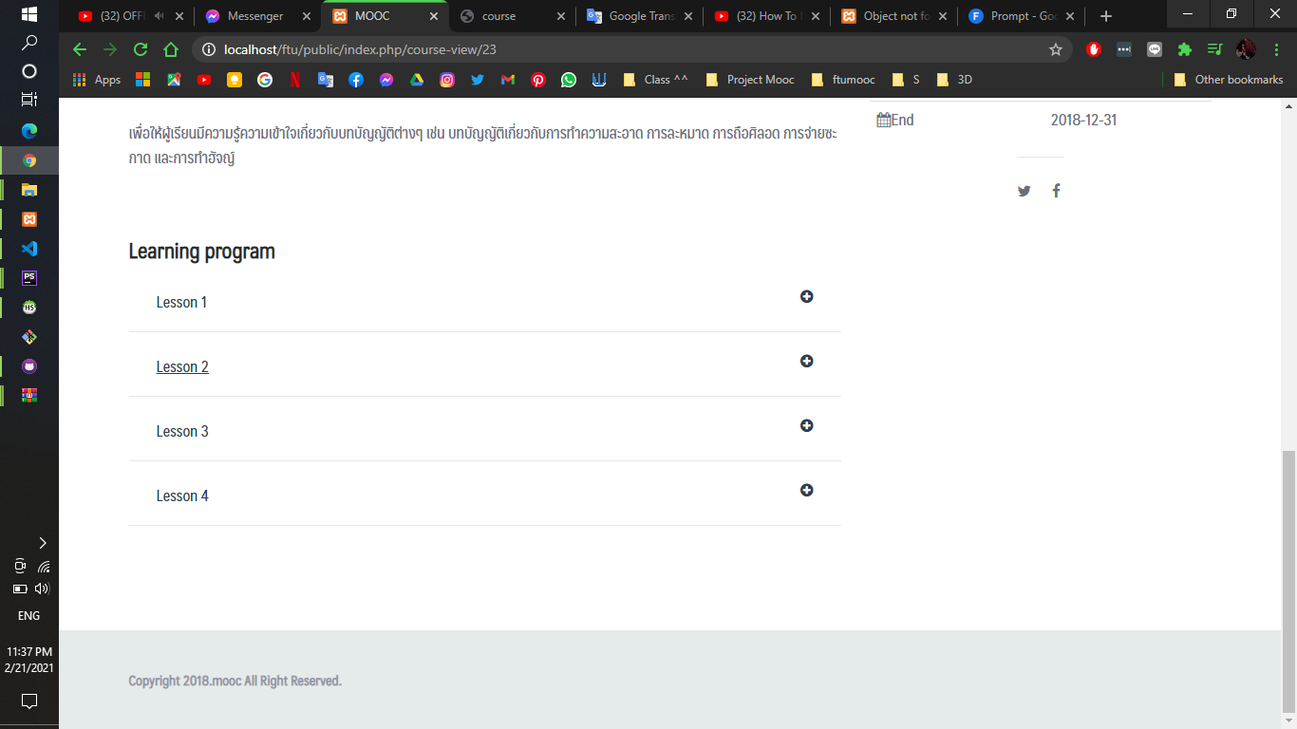
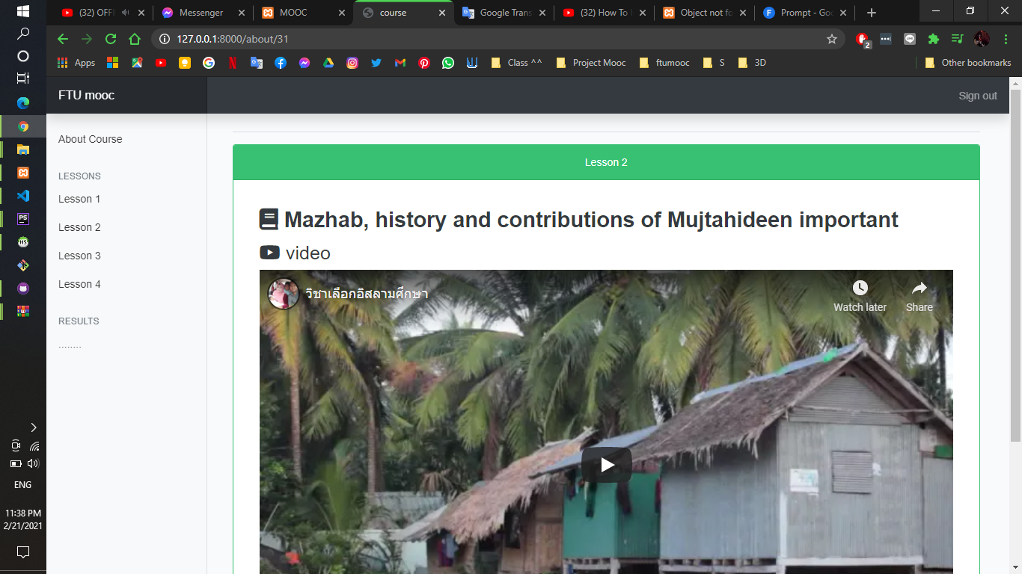
Learning program page

Slide 35
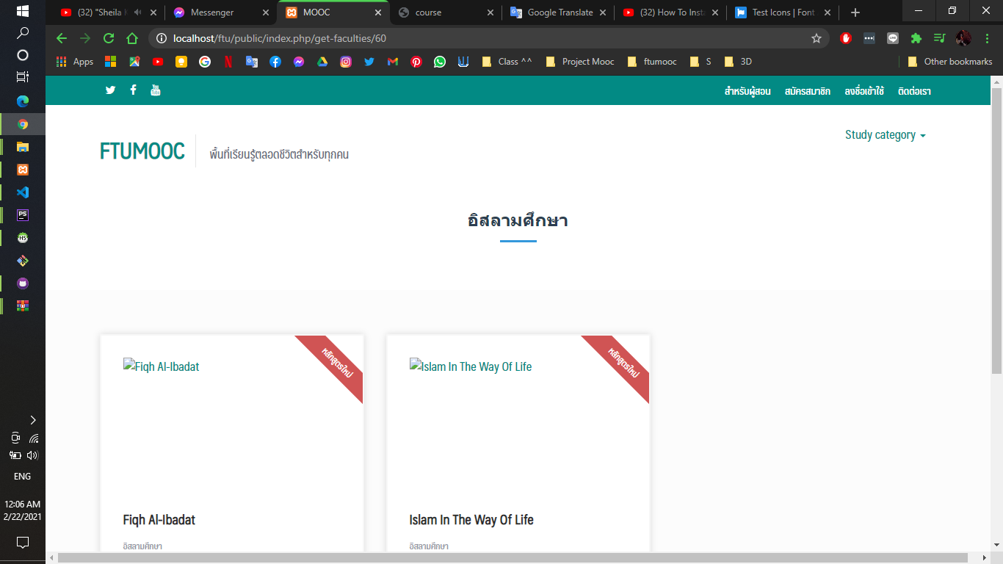
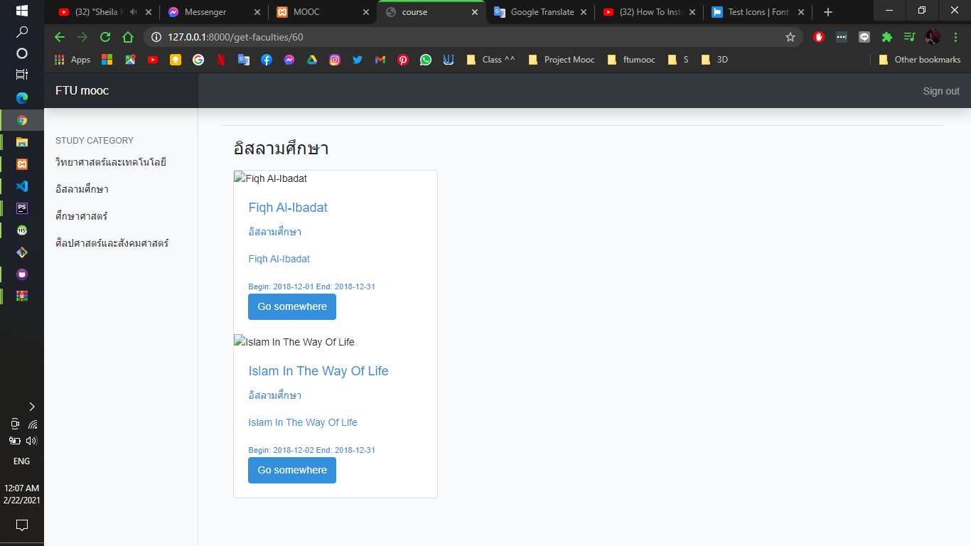
Study category page

Slide 36
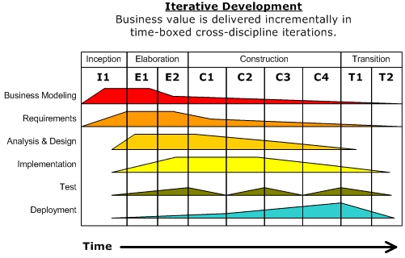
METHODOLOGY
04
Figure 1: Rational Unified Process (RUP)

Slide 37
METHODOLOGY
04
Major Milestones
Inception
Elaboration
Construction
Transition
Time
The Rational Unified Process divides into four consecutive phases :
- Inception – Define the scope of project
- Elaboration – Plan project, specify features, baseline, architecture
- Construction - Build the system
- Transition- Deploy the system into end-user community

Slide 38
SUMMARY
05
students can learn the subject by their wants and learn with the proper time and their conveniences. This way can expand the channels of communication between teachers of Fatoni University and who interested to learn. The main purpose of this
FTU MOOC is to give an opportunity about learning and make convenience for students who interest any subject and give an opportunity for the student who has a low cost.

Slide 39

THANKS YOU !

